Slide 1
Building an AI Pipeline for Image Segmentation and Object Analysis

Slide 2
Objectives
Image Segmentation
Mask R-CNN Deep learning Model
Object Extraction and Storage
Object Identification: YOLOv5 model
Text/Data Extraction from Objects
Summarization and Data Mapping
Streamlit Testing App

Slide 3
Image Segmentation
Image Segmentation: A process of dividing an image into distinct regions or objects to simplify analysis, often used for object detection and recognition tasks.
Mask R-CNN: A popular deep learning model used for segmentation that predicts pixel-level masks for each object in an image.
Visualizing Segmentation: Segmented objects are overlaid with distinct colors on the original image to highlight boundaries and help interpret the results.
Application: Segmentation aids in medical imaging, autonomous driving, and industrial inspection by isolating critical elements within images.
Pipeline: The workflow involves feeding an image into the model, extracting object masks, visualizing the output, and further processing (e.g., text extraction, attribute summarization).

Slide 4
Mask R-CNN Deep learning Model
Mask R-CNN is an advanced deep learning model for image segmentation that extends Faster R-CNN.
Object Detection with Segmentation: Mask R-CNN detects objects and also provides pixel-level segmentation masks for each object.
Two-stage Process: First, it generates object proposals, and then it predicts the object class, bounding box, and segmentation mask for each region.
RoIAlign for Precision: It improves pixel-level accuracy by aligning the regions of interest using the RoIAlign technique.
Multi-task Learning: The model simultaneously predicts object classes, bounding boxes, and masks, optimizing for all three tasks.
Applications: Used in autonomous driving, medical imaging, and video analysis for precise object segmentation.

Slide 5
Object Extraction and Storage
This involves segmenting objects from an image using advanced algorithms (like Mask R-CNN) and saving each object as a separate file, along with their metadata. This step prepares the data for further analysis or processing.
output_dir="/content/drive/MyDrive/Image_Segmentation/Project_root/data/segmented_objects

Slide 6
Object Identification: YOLOv5 model
Real-Time Detection: YOLOv5 is a state-of-the-art object detection model that identifies and classifies multiple objects in images or video streams quickly and accurately.
Architecture: It features a backbone for extracting image features, a neck for generating feature pyramids, and a head for predicting bounding boxes and class probabilities.

Slide 7
Text Extraction from Images Using Pytesseract
Pytesseract is an interface for Tesseract-OCR, which is an open-source OCR engine developed by Google. It is designed to recognize and extract text from images, supporting various languages and text formats. Pytesseract simplifies the process of implementing OCR in Python, allowing users to extract text from images with minimal effort.
Text Recognition: Pytesseract applies OCR algorithms to detect and recognize characters in the image.
Result Output: The extracted text is returned as a string, which can then be saved, displayed, or further processed.

Slide 8
Summarization and Mapping
Step 5: Summarize Object Attributes
Summarize key attributes of each identified object from the segmented images, including size, color, and any extracted text. Organize this information in a structured format for efficient processing and analysis.
Step 6: Data Mapping
Create a comprehensive mapping of each object's attributes to unique IDs and the master image. Store the data in a structured format, such as JSON or CSV, to facilitate easy querying and manipulation.
Step 7: Output Generation
Generate a visual output by annotating the original image with the segmented objects and compiling a summary table of mapped data. Save both the annotated image and the summary table for further analysis and reporting.

Slide 9
Streamlit Testing App
User-Friendly Interface: Provides an intuitive interface for users to upload images for segmentation and analysis.
Image Display: Allows users to view the uploaded image alongside the segmented output in real-time.
Data Visualization: Displays a summary table of object attributes extracted from the image, facilitating easy interpretation of results.
Pipeline Integration: Integrates various stages of the image processing pipeline, enabling seamless testing and validation of the segmentation process.
Output Options: Offers functionality to download annotated images and summary tables for further analysis and reporting.

Slide 10
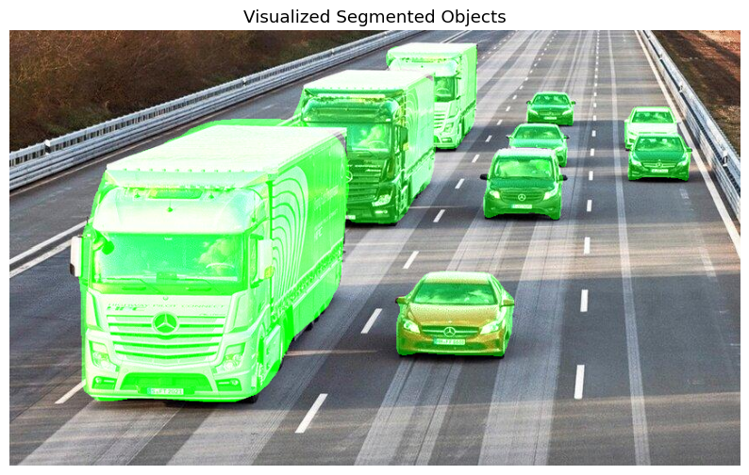
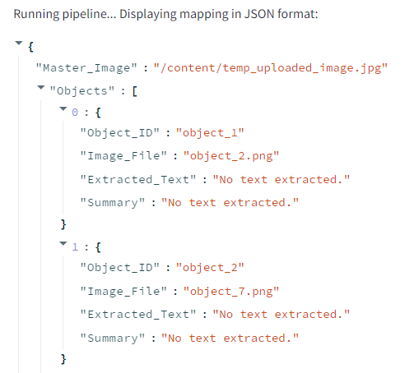
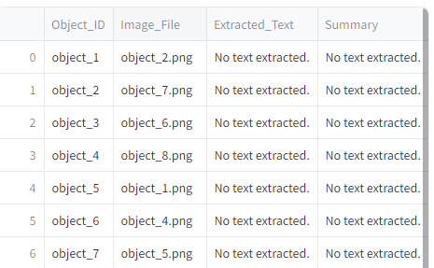
Output Snaps

